Slide 1
CELL DIVISION IN PROKARYOTIC AND EUKARYOTIC CELL

Slide 2
Introduction
The growth and development of any organism depend on cell division
In unicellular organism, it results in the reproduction of entire organism
In Multicellular organism, it results in reproduction and growth of an organism
Three types of cell division:
Binary fission- prokaryotes
Mitosis- Eukaryotes (Somatic cell)
Meiosis- Eukaryotes (Gametes)

Slide 3
PROKARYOTIC CELL DIVISION
BINARY FISSION:
In unicellular organism for example in bacteria, asexual reproduction occurs by a process called Binary fission
This is the division of the cell into two identical copies of daughter cells from the parent cell

Slide 4
BINARY FISSION PROCESS
Binary fission begins with a single circular DNA molecule being attached to mesosome
Cell wall and cell surface membrane are enlarged and DNA starts to replicate in both directions
Once, DNA replication complete and second DNA molecules become attached to mesosome
The mesosome may also be attached to the new cross-walls that are laid down between the daughter cells
New cell wall and membrane grow between DNA molecules and finally, two daughter cells were formed
In the fast-growing bacteria such division may occur as often as every 20 minutes

Slide 5
BINARY FISSION OF BACTERIAL CELL DIVISION

Slide 6
CELL DIVISION OF EUKARYOTIC CELL
CELL CYCLE :
Cell cycle is defined as the sequence of events by which a cell duplicates its genome, synthesizes the other constituents of the cell and eventually divides into two daughter cells
Cell cycle includes three processes cell division, DNA replication and cell growth in coordinated way
Duration of cell cycle can vary from organism to organism and also from cell type to cell type.
(e.g., Yeast cell cycle is of 90 minutes, human 24 hrs)

Slide 7
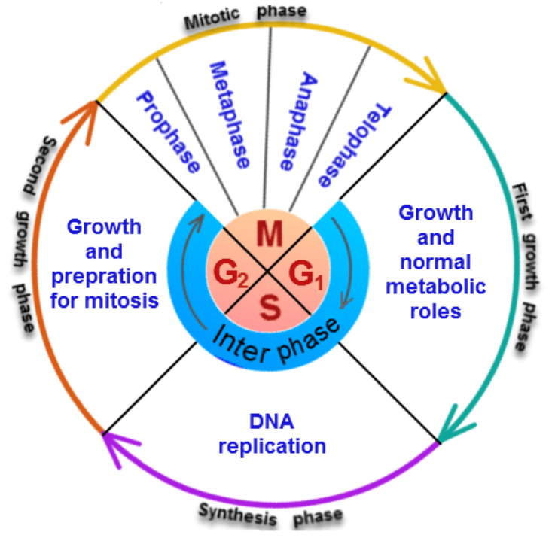
INTERPHASE
G1 PHASE
(Gap 1 Phase)
Corresponds to the interval between mitosis and initiation of DNA replication.
During G1 phase the cell is metabolically active and continuously grows but does not replicate its DNA.

Slide 8
S phase (synthesis phase)
During this period during which DNA synthesis or replication takes place
During this time the amount of DNA per cell doubles. (only amount of DNA is doubled, no of chromosomes remain same)
In animal cells, during the S phase, DNA replication begins in the nucleus, and the centriole duplicates in the cytoplasm.

Slide 9
G2 phase(Gap 2 Phase):
Proteins are synthesised in preparation for mitosis while cell growth continues.
Some cells do not exhibit division like heart cells, nerve cells etc. these cells enter in an inactive phase called G0 or quiescent phase from G1 phase.
Cells in this phase are metabolically active but they do not divide unless they are called on to do so.

Slide 10
Mitosis or M phase
In animals, mitotic cell division is only seen in the diploid somatic cells while in the plants mitotic divisions can be seen in both haploid and diploid cells.
It is also called as equational division as the number of chromosomes in the parent and progeny cells are the same
Mitosis is divided into the following four stages:
Prophase
Metaphase
Anaphase
Telophase

Slide 11
Prophase
It follows the S and G2 phases of interphase.
The centrioles now begin to move towards opposite poles of the cell.
Chromosomal material condenses to form compact mitotic chromosomes.
Initiation of the assembly of mitotic spindle with the help of the microtubules.
Cell organelles like Golgi complexes, endoplasmic reticulum, nucleolus and the nuclear envelope disappear.

Slide 12
Metaphase
complete disintegration of the nuclear envelope
condensation of chromosomes is completed
The morphology of chromosomes is most easily studied
metaphase chromosome is made up of two sister chromatids, which are held together by the centromere
centromere serve as the sites of attachment of spindle fibres to the chromosome and they moved into position at the centre of the cell
Metaphase is characterised by all the chromosomes coming to lie at the equator with one chromatid of each chromosome connected by its kinetochore from one pole to sister chromatid from the opposite pole
The plane of alignment of the chromosomes at metaphase is referred to as the metaphase plate or equatorial plate

Slide 13
Anaphase
At the onset of anaphase, each chromosome arranged at the metaphase plate is split
simultaneously and the two daughter chromatids begin to move towards the two opposite poles
As each chromosome moves away from the equatorial plate, the centromere of each chromosome is moved towards the pole along with chromosome

Slide 14
Telophase
At the beginning of telophase, the chromosomes at their respective poles decondense and form chromatin network.
Nuclear envelope assembles around the chromatin network.
Nucleolus, Golgi complex and ER etc cell organelles reform.

Slide 15
Cytokinesis
After karyokinesis the cell itself is divided into two daughter cells by a separate process called cytokinesis.
In an animal cell, this is achieved by the appearance of a furrow in the plasma membrane.
The furrow gradually deepens and ultimately joins in the centre dividing the cell cytoplasm into two.
The formation of the new cell wall begins with the formation of a simple precursor, called cell-plate that represents the middle lamella between the walls of two adjacent cells.
organelles like mitochondria and plastids get distributed between the two daughter cells.

Slide 16
Significance of mitosis
(1) Mitosis results in the production of diploid daughter cells with identical genetic complement
(2) Growth of multicellular organisms is due to mitosis
(3) This cell division helps to restore the nucleo-cytoplasmic ratio
(4) mitosis is important in cell repair (somatic cells) eg. The cells of the upper layer of the epidermis, cells of the lining of the gut, and blood cells are being constantly replaced
(5) Mitotic divisions in the meristematic tissues – the apical and the lateral cambium, result in a continuous growth of plants

Slide 17
Meiosis
The specialised kind of cell division that reduces the chromosome number by half results in the production of haploid daughter cells called meiosis
It is responsible for formation of haploid gametes, which during sexual reproduction form diploid zygote by fusion
Meiosis involves two sequential cycles of nuclear and cell division called meiosis I and meiosis II but only a single cycle of DNA replication
Interphase of meiosis is similar to interphase of mitosis

Slide 18
Meiosis I
Prophase 1:
Prophase of the meiosis I division is typically longer and more complex than prophase of mitosis.
It has been further subdivided into the following five phases based on chromosomal behaviour.

Slide 19
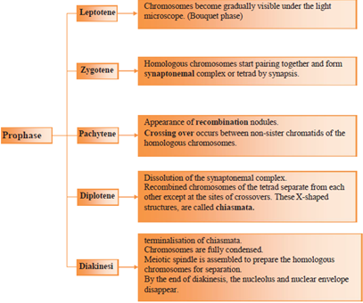

Slide 21
Metaphase I:
The bivalent chromosomes align on the equatorial plate.
The microtubules from the opposite poles of the spindle attach to the pair of homologous chromosomes

Slide 22
anaphase I
The chromatids of chromosome starts to separate and form two chromosomes
Spindle fibres contract pulling the daughter chromosomes to the opposite poles

Slide 23
Telophase I
The nuclear membrane and nucleolus reappear.
cytokinesis follows telophase I.
Although in many cases the chromosomes do undergo some dispersion, they do not reach the extremely extended state of the interphase nucleus. The stage between the two meiotic divisions is called interkinesis and is generally short lived.
Interkinesis is followed by prophase II, a much simpler prophase than prophase I.

Slide 24
Meiosis II
Meiosis II resembles a normal mitosis.

Slide 25
Prophase II:
Meiosis II is initiated immediately after cytokinesis.
The nuclear membrane disappears by the end of prophase II.
The chromosomes again become compact.

Slide 26
Metaphase II:
At this stage the chromosomes align at the equator and the microtubules from opposite poles of the spindle get attached to the kinetochores of sister chromatids.

Slide 27
Anaphase II:
splitting of the centromere of each chromosome.
Chromosomes move toward opposite poles of the cell.

Slide 28
Telophase II:
the two groups of chromosomes once again get enclosed by a nuclear envelope.
cytokinesis follows resulting in the formation of four haploid daughter cells).

Slide 30
SIGNIFICANCE OF MEIOSIS
(1) conservation of specific chromosome number of each species is achieved across generations in sexually reproducing organisms.
(2) It also increases the genetic variability in the population of organisms from one generation to the next. Variations are very important for the process of evolution.

Slide 31
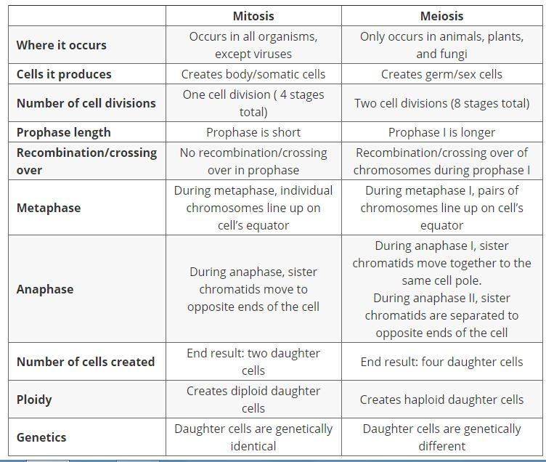

Slide 32
CELL DIFFERENTIATION
Immature cell evolves into a specialized cell, reaching its mature form and function.
When a cell differentiates (becomes more specialized), it may undertake major changes in its size, shape, metabolic activity, and overall function.

Slide 33
Multicellular organisms require different types of cells for these processes to be possible.
Here, different types of cells play a specific function given that they have varied structures.
For instance, whereas the nerve cells play a crucial role in the transmission of signals to different parts of the body, blood cells play an important role in carrying oxygen to different parts of the body.
The differences in structure and functions between the cells mean that they are specialized cells.

Slide 34
A cell capable of differentiating into any one type of cell is known as "totipotent".
For mammals, totipotent includes the zygote and products of the first few cell divisions.
There are also certain types of cells that can differentiate into many types of cells. These cells are known as "pluripotent" or stem cells in animals (meristemic cells in higher plants).

Slide 35
Examples of stem and progenitor cells
Hematopoietic Stem Cells:
These are present in bone marrow and are involved in the production of red and white blood cells as well as the platelets.
Mesenchymal Stem Cells
Also from the bone marrow, these cells are involved in the production of fat cells, stromal cells as well as a given type of bone cell.

Slide 36
Epithelial Stem Cells
These are progenitor cells and are involved in the production of certain skin cells.
Muscle Satellite Cells
These are progenitor cells that contribute to differentiated muscle tissue.

Slide 37
Cell Differentiation Significance
Cell differentiation is an important process through which a single cell gradually evolves allowing for development that not only results in various organs and tissues being formed, but also a fully functional animal.
In cell differentiation, gene expression is particularly important given that there are vital control systems that only ensure certain differentiation
Knowledge of cell differentiation has also influenced stem cell research. Today, scientists and researchers are working to use stem cells for the regenerating and repairing cellular damage
Stem cells can continue differentiating into a number of specialized cells to renew and repair the tissue

Slide 38
THANK YOU

